Slide 1
Tutorial 4
Statistical Computation and Analysis
Spring 2026

Slide 2
Tutorial Outline
Short revision on lecture 4
Lecture 5 models

Slide 3
Revision
Bayesian workflow
Sampling diagnostics
Divergences
Validation
Prior predictive plots
Posterior predictive plots
Notes:
This is partial revision.
The algorithms are also important!

Slide 4
Bayesian workflow
Data
Model
Sample
Posterior
Inference
Notes:
Up untill now

Slide 5
Bayesian workflow
Diagnostics
Data
Model
Sample
Posterior
Inference
Posterior predictive sampling
Prior predictive sampling
Notes:
New Definitions and Terms
• Bayesian workflow — an iterative process for building, checking, sampling, and revising statistical models
• Sampling validity — whether the algorithm actually sampled from the posterior distribution
• Model fit — whether the fitted model can generate data resembling the observed data
• Prior predictive sampling — simulating parameters from the prior and data from the likelihood before fitting the model
• Posterior predictive sampling — simulating new data from parameter values drawn from the posterior
• Iterative workflow — the process of revising data procedures, priors, models, parameterizations, or sampler settings when checks fail

Slide 6
Bayesian workflow
Sampling validity
Diagnostics
Data
Model
Sample
Posterior
Inference
Posterior predictive sampling
Prior predictive sampling
Model coherence
Model fit
Notes:
New Definitions and Terms
• Bayesian workflow — an iterative process for building, checking, sampling, and revising statistical models
• Sampling validity — whether the algorithm actually sampled from the posterior distribution
• Model fit — whether the fitted model can generate data resembling the observed data
• Prior predictive sampling — simulating parameters from the prior and data from the likelihood before fitting the model
• Posterior predictive sampling — simulating new data from parameter values drawn from the posterior
• Iterative workflow — the process of revising data procedures, priors, models, parameterizations, or sampler settings when checks fail

Slide 7
Bayesian workflow
Prior predictive sampling - simulating parameters from the prior and data from the likelihood before fitting the model.
Sampling validity - whether the algorithm actually sampled from the posterior distribution.
Model fit - whether the fitted model can generate data resembling the observed data.
Posterior predictive sampling - simulating new data from parameter values drawn from the posterior.
Iterative workflow - the process of revising data procedures, priors, models, parameterizations, or sampler settings when checks fail.
Sampling validity
Diagnostics
Data
Model
Sample
Posterior
Inference
Prior predictive sampling
Posterior predictive sampling
Model coherence
Model fit
Notes:
Fitting the model samples unknown parameters from the posterior after conditioning on the observed data.
Predictive sampling simulates data from the model: prior predictive sampling simulates data before fitting to check whether the model is plausible, while posterior predictive sampling simulates data after fitting to check whether the fitted model can reproduce the observed data.

Slide 8
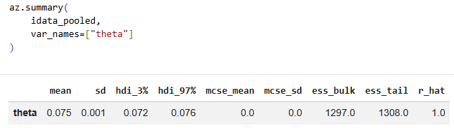
Sampling diagnostics
Posterior Summary

Slide 9
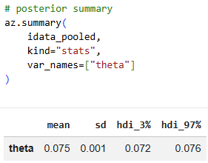
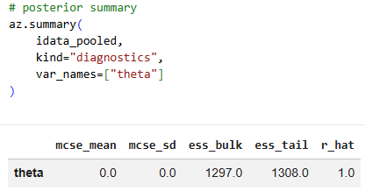
Sampling diagnostics
Posterior Summary
kind=‘stats’ kind=‘diagnostics’
Notes:
We want to see both kinds! Today we’ll focus on the ‘diagnostics’

Slide 10

Sampling diagnostics
Trace plots & divergences
$\hat{R}$
ESS
MCSE

Slide 11

Sampling diagnostics
$\hat{R}$, ESS and MCSE:
Diagnostic metrics used to evaluate whether samples generated by Markov Chain Monte Carlo (MCMC) methods are reliable and have converged properly.

Slide 12
Sampling diagnostics
Effective Sample Size (ESS) - the number of independent draws with roughly equivalent information content.
MCMC methods use the current position to generate the next position, the samples they produce are correlated. Because of this autocorrelation, the actual number of "useful" or independent draws is lower than the total number of samples generated.
You can check the bulk-ESS to see how well the center of the distribution was resolved, or the tail-ESS if you are interested in reporting extreme quantiles or rare events.
Notes:
Example:
4 chains × 1000 draws = 4000 total draws
But if the samples are strongly autocorrelated, many draws are redundant. The ESS might be:
ESS = 600
This means:
These 4,000 correlated MCMC draws are approximately as informative as 600 independent draws from the posterior.

Slide 13

Sampling diagnostics
$\hat{R}$ - a convergence diagnostic comparing between-chain variation to within-chain variation.
Ideally we want $\hat{R}=1$.
Notes:
As an empirical rule of thumb, a value below 1.01 is considered acceptable, while higher values usually signal a lack of convergence. However, values around 1.1 might be acceptable in the early stages of modeling.

Slide 14
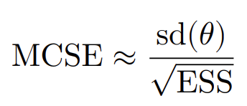
Sampling diagnostics
Monte Carlo Standard Error - Uncertainty in posterior summaries caused by finite sampling.
Should be less than 1–2%.
Notes:
MCSE shows how autocorrelation affects uncertainty.
Even if your chains have converged (low R^) and you have a high ESS, your samples are still finite, meaning there will always be some error in your estimation of the posterior parameters.
MCSE estimates this error, taking into account that your samples are not truly independent

Slide 15
Divergences
Diagnostic warning exclusive to the NUTS (No-U-Turn Sampler) method.
Unlike the other that evaluate the properties of the generated samples, divergences are based on the inner workings of the sampling algorithm itself.
How to fix:
Increase the target_accept parameter: force the sampler to take smaller, more careful steps and resolve the divergences. Default is 0.8, If you have to push this value extremely high (e.g., 0.999 it might not be enough.
Reparameterize the model: rewriting the model in a mathematically equivalent way that creates a friendlier geometry for the sampler.
Notes:
How to Fix Divergences
Increase the target_accept parameter: The easiest first step is to instruct the sampler to increase its target acceptance rate, which defaults to 0.8 (80%). PyMC will often suggest this automatically. Increasing this value to 0.85, 0.90, or even 0.99 can sometimes force the sampler to take smaller, more careful steps and resolve the divergences. However, if you have to push this value extremely high (e.g., 0.999), this simple trick might not be enough
Reparameterize the model: If tweaking the sampler doesn't work, you must change the model itself. Reparametrization means rewriting the model in a mathematically equivalent way that creates a friendlier geometry for the sampler . For example, switching a hierarchical model from a "centered" parametrization to a "non-centered" parametrization can effectively eliminate the funnel shape, transforming it into a more manageable, spherical geometry that the sampler can navigate without triggering divergences

Slide 16
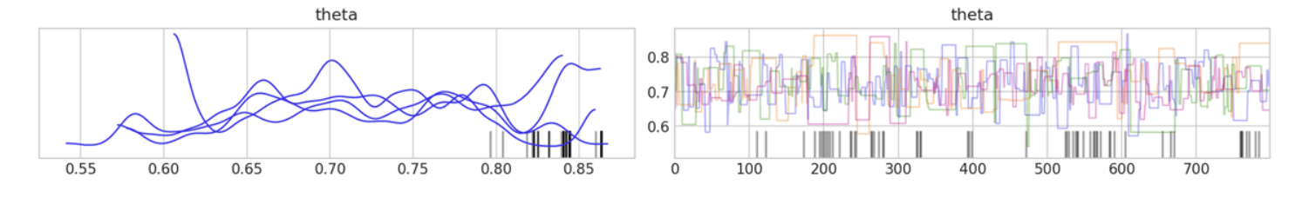
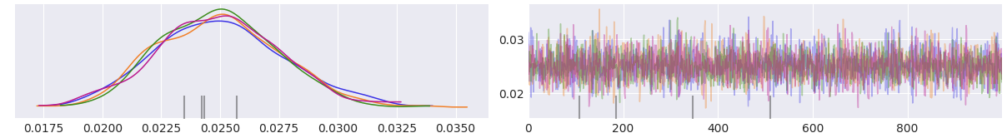
Divergences
Trace plots with divergences examples
Notes:
We can still have divergences with “ok\good looking” trace plots

Slide 17
Validation
Reminder
Prior predictive sampling shows model coherence
Diagnostics shows sampling validity
Posterior predictive sampling shows model fit

Slide 18
Validation
A prior predictive plot shows data simulated from the model before seeing the observed data.
If my priors and likelihood are true, what kind of data could this model generate?
Usually we want the prior predictive samples to be wider than the observed data.

Slide 19
Validation
A posterior predictive plot shows data simulated from the model after fitting the model.
After learning from the observed data, can the model generate data that look like the real data?
Usually we want to see if the fitted model reproduce the important patterns in the observed data

Slide 20
Lecture 5
Pooled & unpooled models
Hierarchical model
Multi-level models

Slide 21
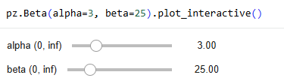
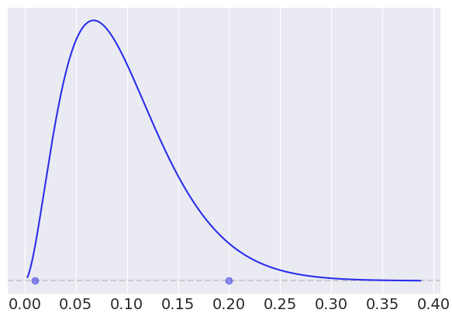
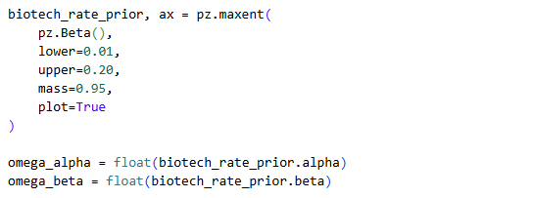

Beta Distribution – Clarification
Up until now we used alpha and beta:
Another function worth knowing:
Notes:
These will be our omega_alpha and omega_beta prior parameters for the rest of the tutorial

Slide 22
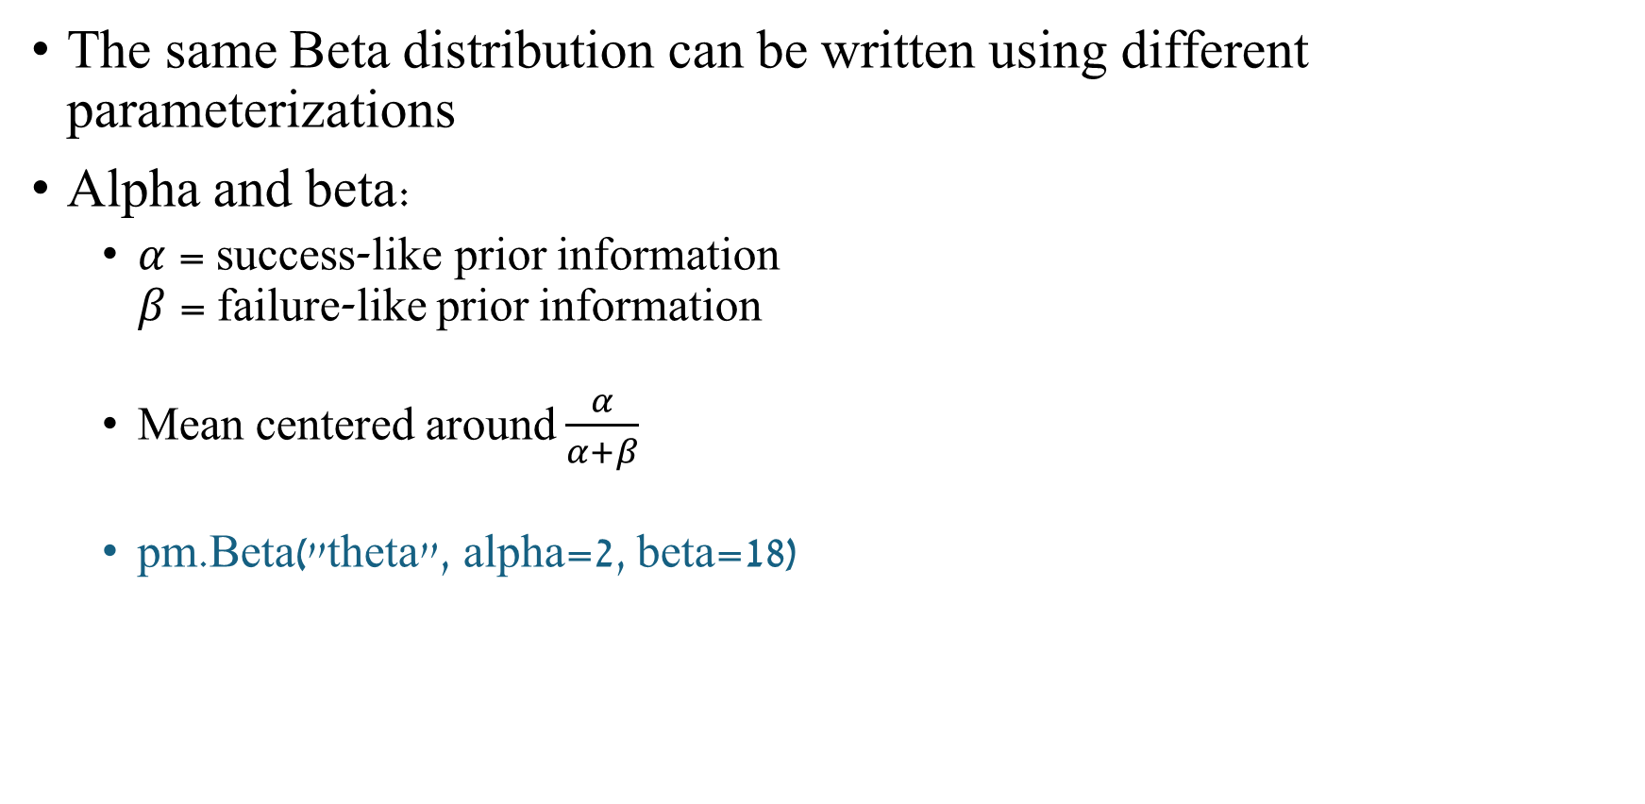
Beta Distribution
The same Beta distribution can be written using different parameterizations
Alpha and beta:
$α$ = success-like prior information $β$ = failure-like prior information
Mean centered around $\frac{α}{α+β}$
pm.Beta("theta", alpha=2, beta=18)
Notes:
mu controls where the distribution is centered. nu controls how narrow or wide it is.

Slide 23

Beta Distribution
We can also use mu and nu:
mu = mean of the Beta distribution nu = concentration around that mean
$μ$ = $\frac{α}{α+β}$ $ν$ = $α+β$
pm.Beta("theta", mu=0.10, nu=20)
Notes:
mu controls where the distribution is centered. nu controls how narrow or wide it is.

Slide 24
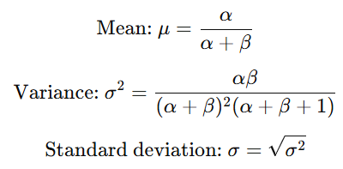
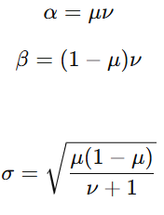
Beta Distribution
Or use mu with sigma:
sigma: standard deviation / width
pm.Beta("theta", mu=0.10, sigma=0.05)
or
Notes:
mu controls where the distribution is centered. sigma controls the width / standard deviation.

Slide 25
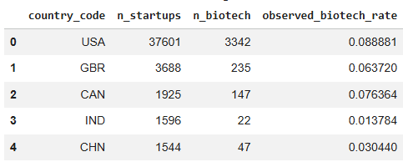
Today’s Dataset
Startup dataset

Slide 26
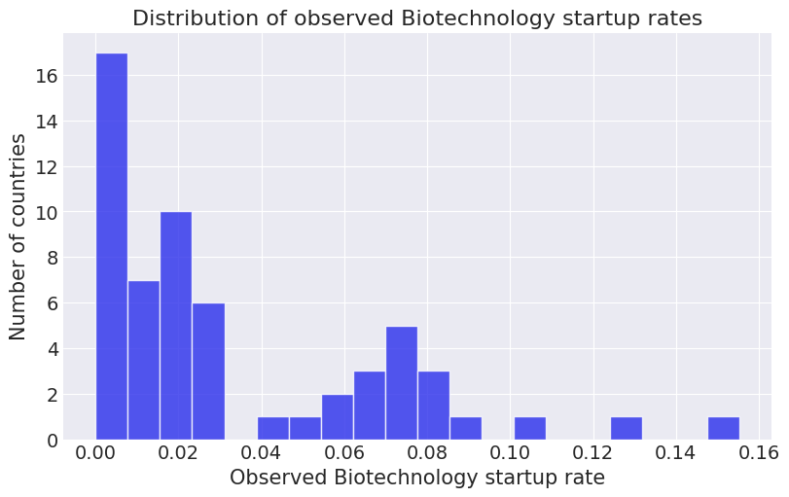
Today’s Dataset

Slide 27
Our current workflow (code wise)
Load & describe at the data
Choose a prior (and hyperpriors)
Write the model + plot it as a graph
Prior predictive check (sample & plot)
Sample & diagnostics (posterior summary, trace plot)
Posterior predictive check (sample & plot)
Posterior (plot & HDI)
Go back and change at any point if needed

Slide 28
Pooled & Unpooled Models

Slide 29
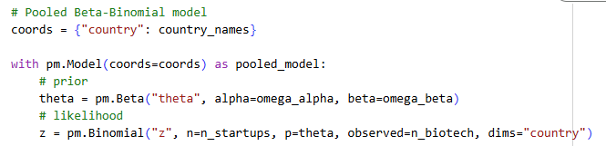
Pooled Models
A model that ignores group structure and estimates a single parameter from all observations together.
The “baseline model, what we’ve done until now.
Notes:
Prior choice –
biotech_rate_prior, ax = pz.maxent(
pz.Beta(),
lower=0.01,
upper=0.20,
mass=0.95,
plot=True
)

Slide 30
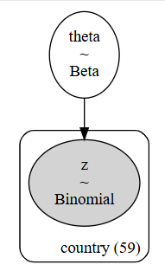
Pooled Models
As a graph:
Notes:
Prior choice –
biotech_rate_prior, ax = pz.maxent(
pz.Beta(),
lower=0.01,
upper=0.20,
mass=0.95,
plot=True
)

Slide 31

Pooled Models
Prior Predictive Check
Sample:
Notes:
Prior choice –
biotech_rate_prior, ax = pz.maxent(
pz.Beta(),
lower=0.01,
upper=0.20,
mass=0.95,
plot=True
)

Slide 32
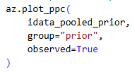
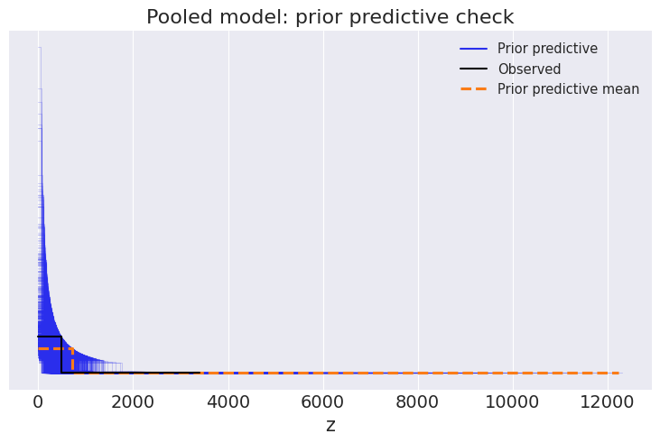
Pooled Models
Prior Predictive Check
Sample
Plot:
az.plot_ppc() – for “z” (number of startups in biotech. * Mainly used for count data in the discrete models
Notes:
Prior choice –
biotech_rate_prior, ax = pz.maxent(
pz.Beta(),
lower=0.01,
upper=0.20,
mass=0.95,
plot=True
)

Slide 33
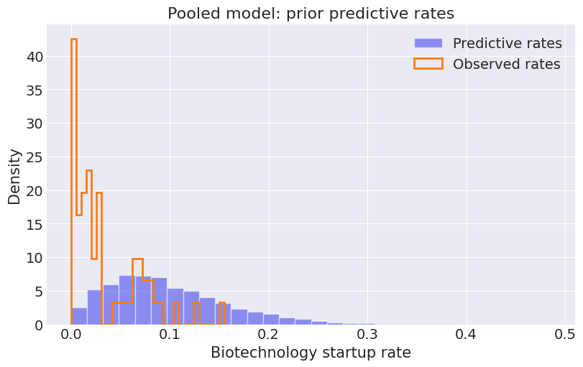
Pooled Models
Prior Predictive Check
Sample
Plot:
2. Create a function that extracts the idata, converts the counts to rates and plots it using plt.hist()
*Note – I created a “helper function” to plot both the prior & posterior predictive.
Notes:
Prior choice –
biotech_rate_prior, ax = pz.maxent(
pz.Beta(),
lower=0.01,
upper=0.20,
mass=0.95,
plot=True
)

Slide 34
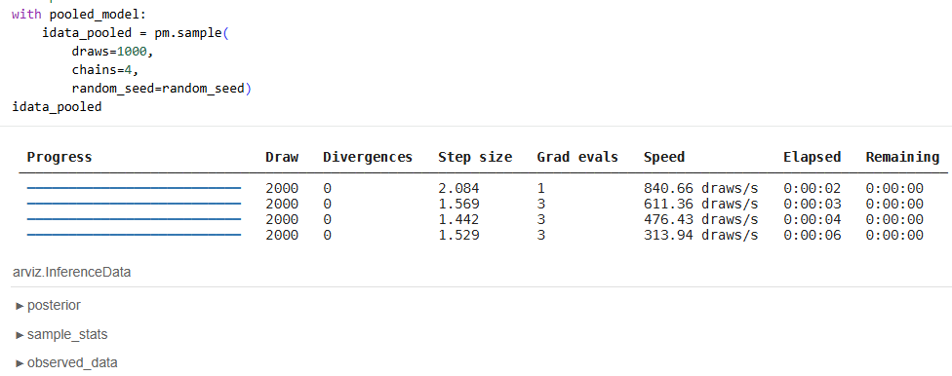
Pooled Models
Sample
Notes:
Prior choice –
biotech_rate_prior, ax = pz.maxent(
pz.Beta(),
lower=0.01,
upper=0.20,
mass=0.95,
plot=True
)

Slide 35
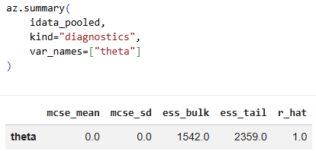
Pooled Models
Posterior summary
Notes:
Today we focus on the diagnostics but the stats are also important.

Slide 36
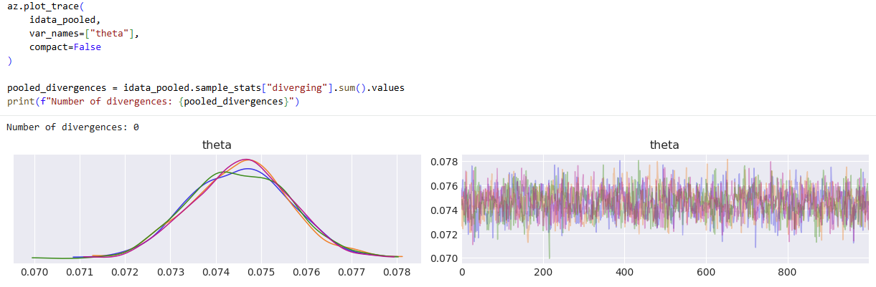
Pooled Models
Diagnostics
Notes:
Prior choice –
biotech_rate_prior, ax = pz.maxent(
pz.Beta(),
lower=0.01,
upper=0.20,
mass=0.95,
plot=True
)

Slide 37
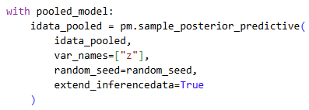
Pooled Models
Posterior Predictive Check
Sample the posterior:
Notes:
Prior choice –
biotech_rate_prior, ax = pz.maxent(
pz.Beta(),
lower=0.01,
upper=0.20,
mass=0.95,
plot=True
)

Slide 38
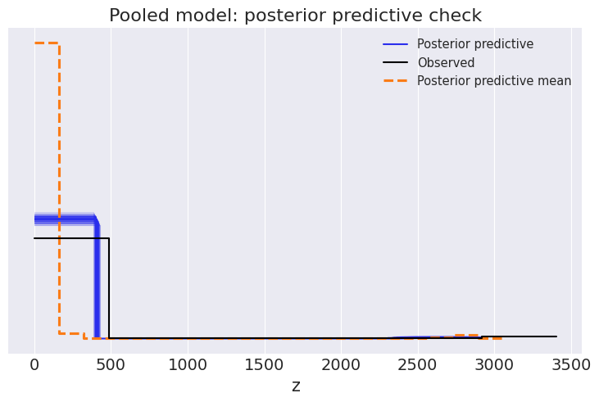
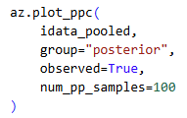
Pooled Models
Posterior Predictive Check
Sample the posterior
Plot:
Using az.plot_ppc()
Notes:
Prior choice –
biotech_rate_prior, ax = pz.maxent(
pz.Beta(),
lower=0.01,
upper=0.20,
mass=0.95,
plot=True
)

Slide 39
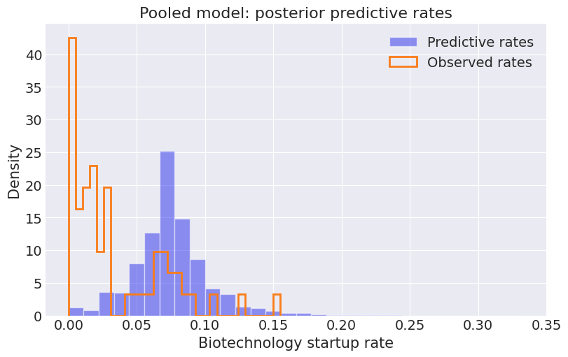
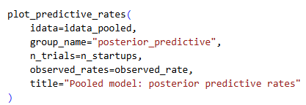
Pooled Models
Posterior Predictive Check
Sample the posterior
Plot:
2. Using our helper function:
Notes:
Prior choice –
biotech_rate_prior, ax = pz.maxent(
pz.Beta(),
lower=0.01,
upper=0.20,
mass=0.95,
plot=True
)

Slide 40
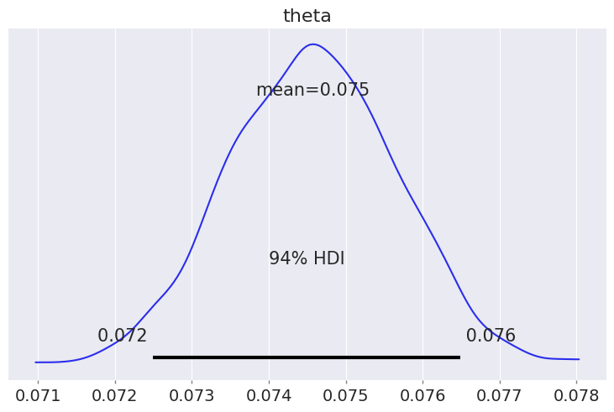
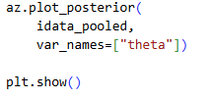
Pooled Models
Posterior & HDI

Slide 41
Unpooled Models
A model that estimates separate parameters for each group without sharing information across groups.
No information sharing - a modeling structure in which data from one group do not affect the parameter estimates for other groups.

Slide 42
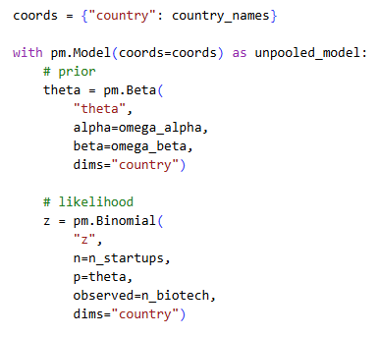
Unpooled Models
The unpooled model estimates a separate Biotechnology startup probability for each country.
There is no information sharing between countries.

Slide 43
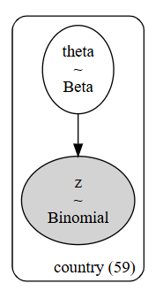
Unpooled Models

Slide 44
Unpooled Models
Unpooled Model Pooled Model
Notes:
In the unpooled model, we have different prior parameter (theta) for each country

Slide 45
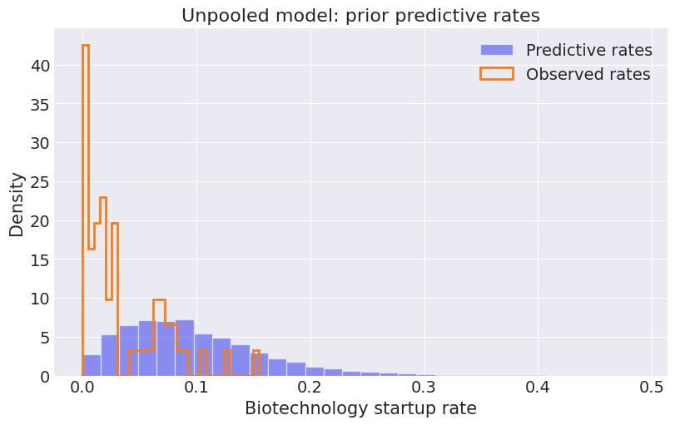
Unpooled Models
Prior predictive
Unpooled Model Pooled Model

Slide 46
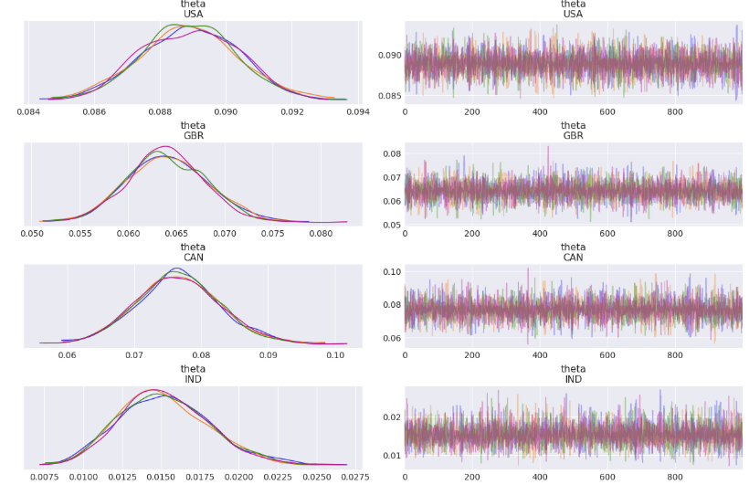
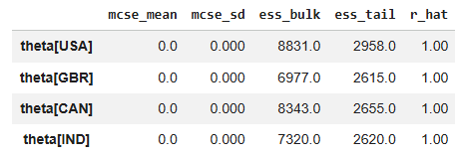
Unpooled Models
Summary & trace plot shows the different thetas:
Notes:
These are just part of them

Slide 47
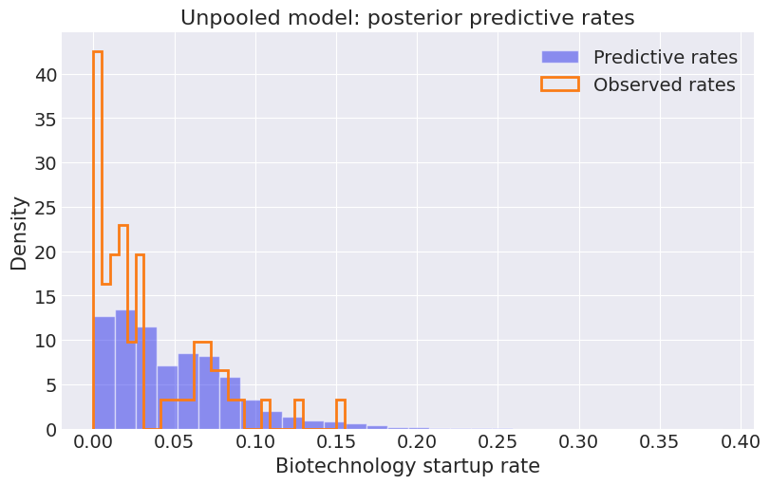
Unpooled Models
Posterior predictive -
Unpooled Model Pooled Model

Slide 48
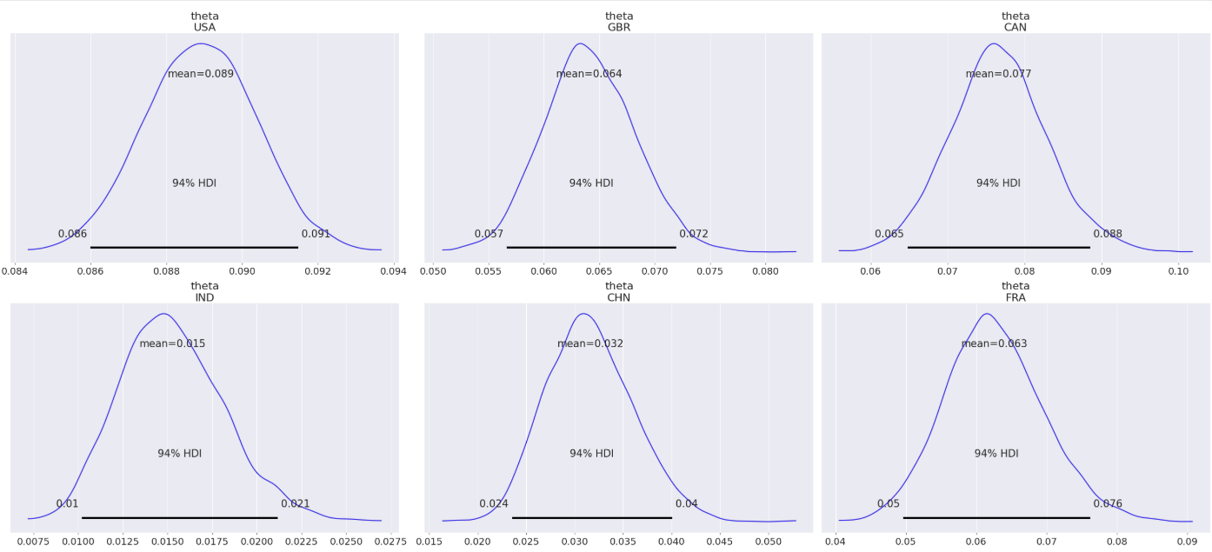
Unpooled Models
Instead of one posterior we have a different one for each country
Notes:
These are just part of them

Slide 49
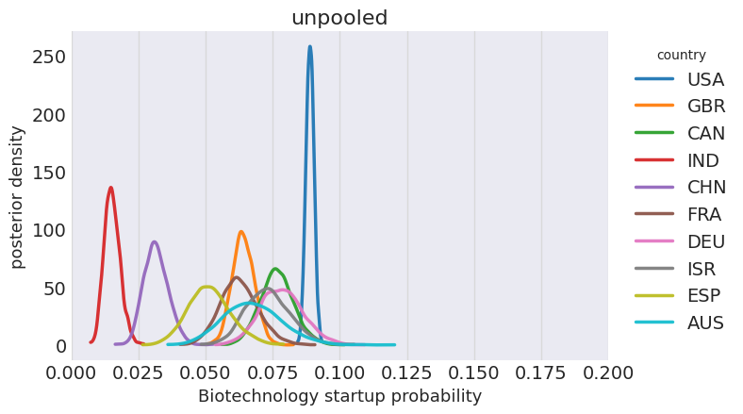
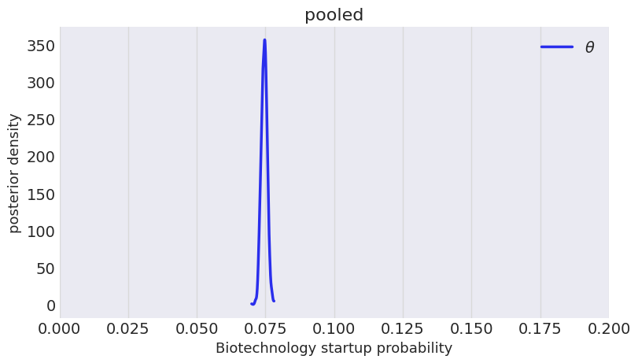
Unpooled Models
Instead of one posterior we have a different one for each country
Notes:
These are just part of them

Slide 50
Hierarchical Models

Slide 51
Hierarchical Models
A model in which parameters for lower-level groups are themselves modeled as coming from a higher-level distribution.
Hyperparameter - a parameter of a prior distribution.
Hyperprior - a prior distribution placed on a hyperparameter.
Information sharing - the way group-level parameter estimates are influenced by data from other groups through shared hyperparameters.

Slide 52
Hierarchical Models
In our dataset -
The hierarchical model estimates a separate Biotechnology startup probability for each country.
The country probabilities are connected through shared hyperparameters.
This creates information sharing between countries.

Slide 53
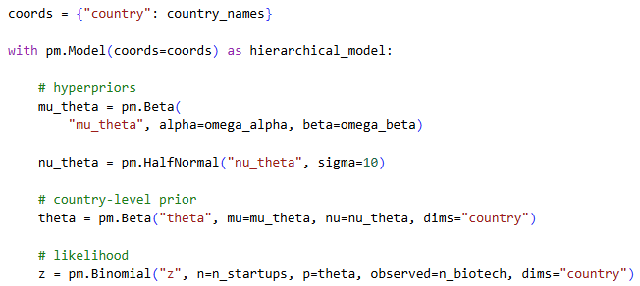
Hierarchical Models
Notes:
For nu we want only positive distributions (no negative values). We usually use HalfNormal\Gamma.

Slide 54
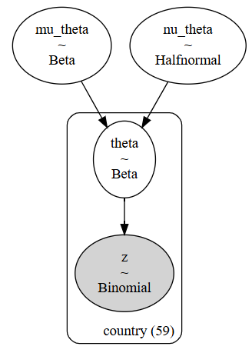
Hierarchical Models
Hierarchical Model Unpooled model Pooled Model

Slide 55
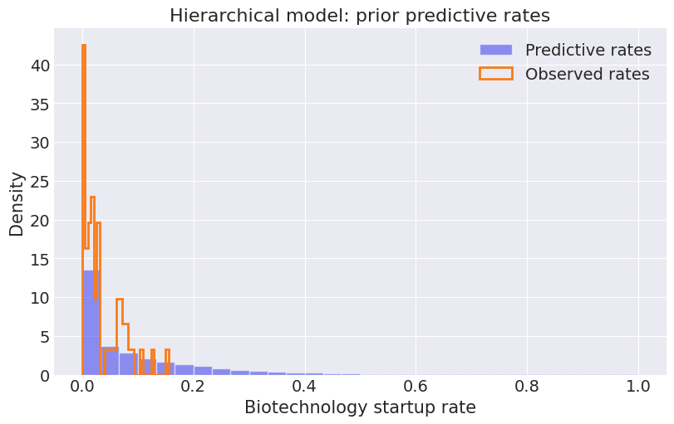
Hierarchical Models
Prior Predictive

Slide 56
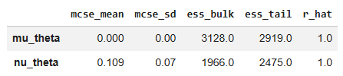
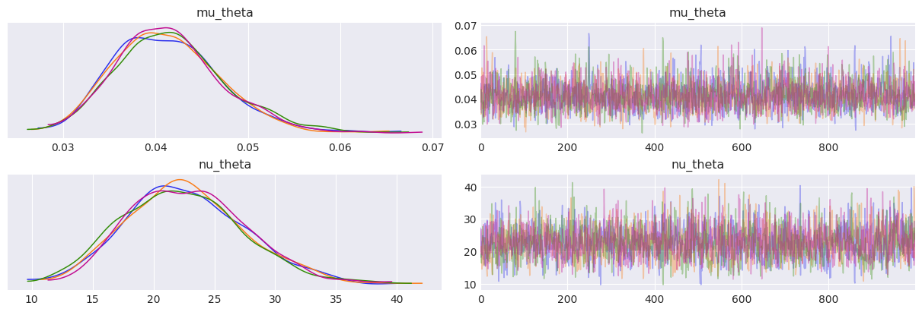
Hierarchical Models
Sample & diagnostics for hyperpriors

Slide 57
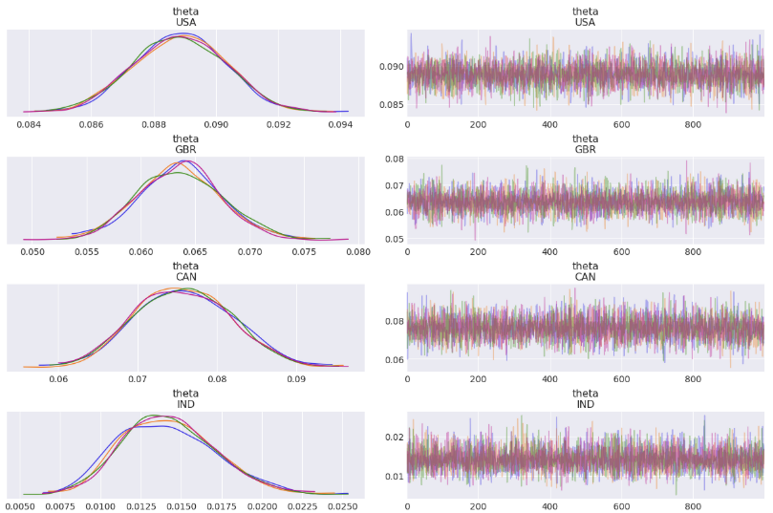
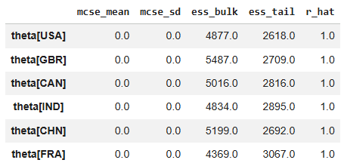
Hierarchical Models
Sample & diagnostics for country-level prior

Slide 58
Funnels
Funnel - posterior geometry in which changes in a scale parameter strongly change the available range of other parameters.
Location parameter - a parameter describing the center of a distribution, such as a mean, median, or mode.
Scale parameter - a parameter describing the spread of a distribution, such as a standard deviation, variance, or interquartile range.
Centered parameterization - a hierarchical parameterization in which group parameters are drawn directly from a distribution controlled by unknown hyperparameters.
Non-centered parameterization - a reparameterization that separates standardized group variation from the unknown scale parameter.

Slide 59
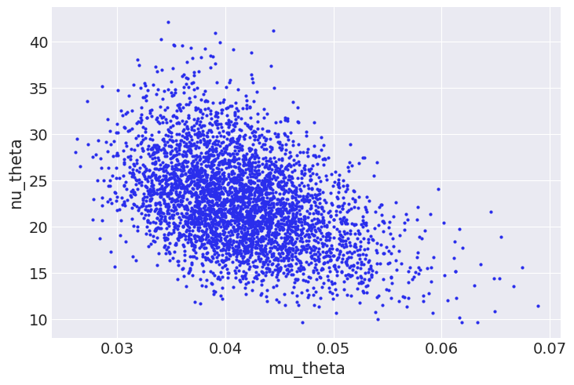

Funnels

Slide 60

Hierarchical Models
Posterior Predictive

Slide 61

Hierarchical Models
Posterior for the hyperparameters

Slide 62

Hierarchical Models
Posterior for theta

Slide 63

Shrinkage
The estimates have shrunk toward the common mean due to each group informing the rest, and each group being informed by the estimation of the others.
Notes:
The estimates have shrunk toward the common mean due to each group informing the rest, and each group being informed by the estimation of the others

Slide 64

Shrinkage
HDI width shrinkage - reduction in posterior interval width, especially for groups with less data, due to hierarchical information sharing.
Notes:
The estimates have shrunk toward the common mean due to each group informing the rest, and each group being informed by the estimation of the others

Slide 65

Multi-level Hierarchical Model
The multi-level model adds another level of group structure.
Each city has its own Biotechnology startup probability.
Cities from the same country are connected through country-level hyperparameters.
Here:
Cities are the lower-level groups
Countries are the higher-level groups

Slide 66

Multi-level Hierarchical Model

Slide 67

Multi-level Hierarchical Model
Multi-level Model Hierarchical Model

Slide 68

Multi-level Hierarchical Model
Prior predictive check

Slide 69



Multi-level Hierarchical Model
Summary
Global hyperparameters
Country level hyperparameters
City level parameters

Slide 70



Multi-level Hierarchical Model
We also have trace plots for the same parameters
Global hyperparameters
Country level hyperparameters
City level parameters

Slide 71

Multi-level Hierarchical Model
Posterior Predictive check
Multi-level Hierarchical Model Hierarchical Model

Slide 72



Hierarchical Models
Posterior
Global hyperparameters
Country level hyperparameters
City level parameters

Slide 73




Multi-level Hierarchical Model

